Slide 1

1 / 33
Notes:
Title slide. Introduce the paper: DnCNN by Zhang et al., published in IEEE TIP 2017. One of the most influential papers in image denoising, cited over 6000 times.

Slide 2
OVERVIEW
Presentation Roadmap
PART 1
PART 2
PART 3
PART 4
Introduction & Motivation
Architecture & Design
Data, Training & Results
Analysis & Conclusion
Problem statement
Research gap
Classical methods
Mathematical bridge
Network architecture
Residual learning
RL + BN synergy
Multi-task extension
Datasets & pipeline
Evaluation metrics
Quantitative results
Visual comparisons
Runtime & complexity
Limitations
Conclusions
Future directions
2 / 33
Notes:
Roadmap overview. Four main parts: motivation, architecture, results, and critical analysis. About 40 minutes total including Q&A.

Slide 3
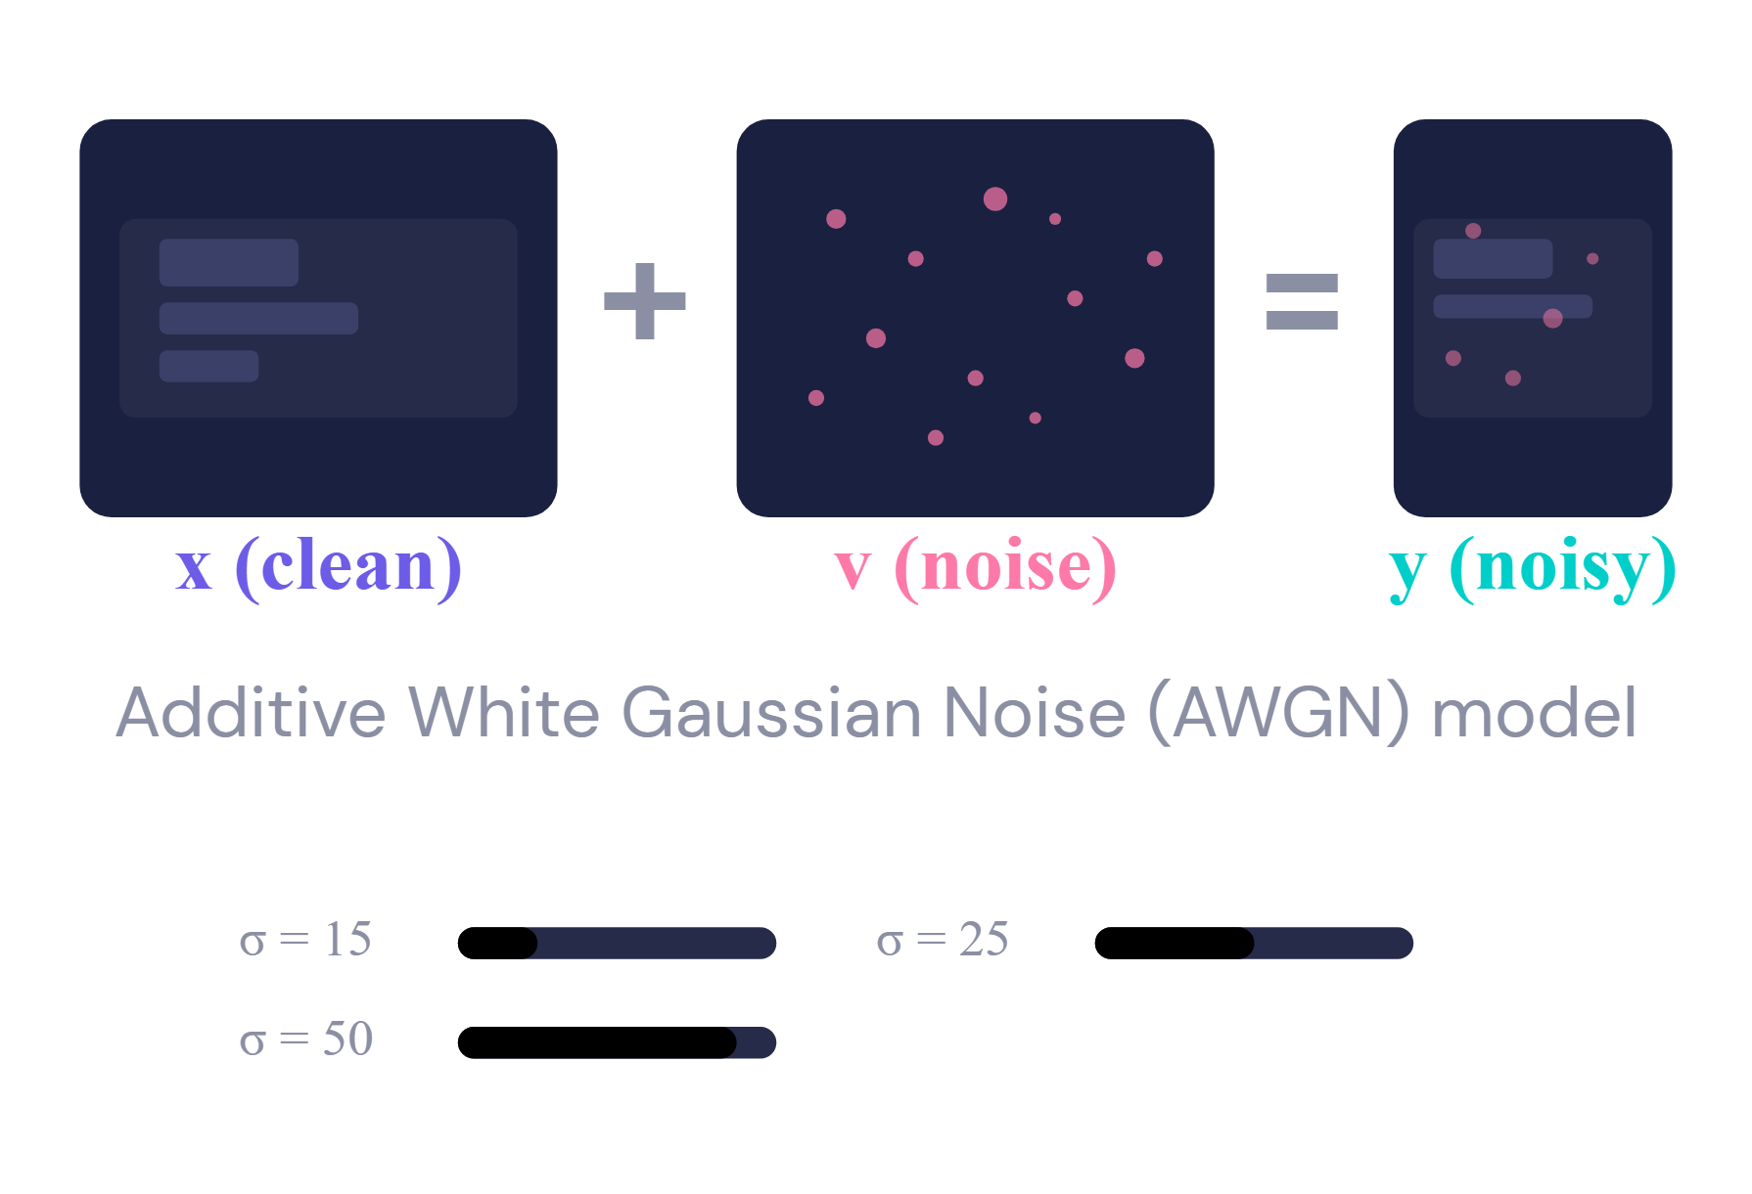
INTRODUCTION
INTRODUCTION
·
·
ARCHITECTURE
ARCHITECTURE
·
·
DATA & TRAINING
DATA & TRAINING
·
·
RESULTS
RESULTS
·
·
ANALYSIS
ANALYSIS
·
·
CONCLUSION
CONCLUSION
INTRODUCTION
The Image Denoising Problem
Image Degradation Model
y = x + v
y Noisy
x Clean
v AWGN (σ)
Applications
Medical imaging — MRI, CT scans
Satellite & remote sensing imagery
Surveillance & security systems
Smartphone & consumer photography
Preprocessing for higher-level vision tasks
KEY INSIGHT
Denoising is ill-posed — infinitely many clean images could produce the same noisy observation.
3 / 33
Notes:
Image denoising: given a noisy observation y, recover clean image x. Noise model is additive white Gaussian. Applications span medical, satellite, surveillance, photography. Problem is ill-posed — infinitely many solutions.

Slide 4



INTRODUCTION
INTRODUCTION
·
·
ARCHITECTURE
ARCHITECTURE
·
·
DATA & TRAINING
DATA & TRAINING
·
·
RESULTS
RESULTS
·
·
ANALYSIS
ANALYSIS
·
·
CONCLUSION
CONCLUSION
INTRODUCTION
Research Gap & Motivation
Limitations of Existing Methods
Research Questions
1
Can a deep CNN with residual learning + batch normalization achieve superior denoising?
Computational Cost BM3D, WNNM: complex test-time optimization — minutes per image
2
Can a single model handle unknown noise levels (blind denoising)?
Noise-Specific Models CSF, TNRD, MLP: separate model per noise level — no blind denoising
3
Can one network handle denoising, SR, and JPEG deblocking?
Limited Priors Analysis-model priors cannot capture full image structure
4
Can RL and BN mutually benefit each other for Gaussian denoising?
Time to denoise a 512×512 image
WNNM
773s
BM3D
2.85s
DnCNN
0.06s
4 / 33
Notes:
Research gap: Three key failures of prior methods. BM3D/WNNM are slow (minutes per image). CSF/TNRD need separate models per noise level. Analysis priors can't capture full image structure. DnCNN addresses all four research questions.

Slide 5
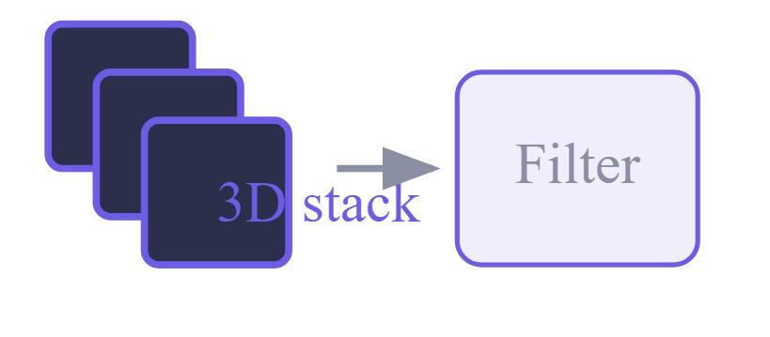

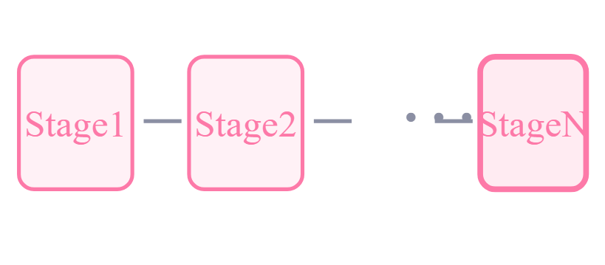
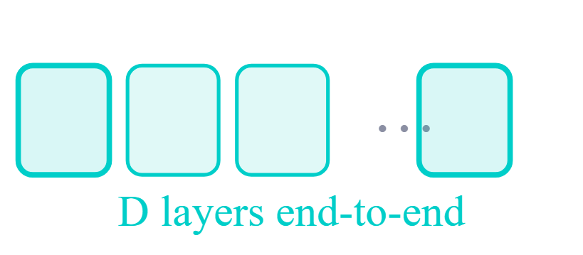
INTRODUCTION
INTRODUCTION
·
·
ARCHITECTURE
ARCHITECTURE
·
·
DATA & TRAINING
DATA & TRAINING
·
·
RESULTS
RESULTS
·
·
ANALYSIS
ANALYSIS
·
·
CONCLUSION
CONCLUSION
CLASSICAL METHODS
Prior-Based Denoising Approaches
BM3D
2007
WNNM
2014
CSF / TNRD
2014–16
DnCNN
2017
Non-local similarity Collaborative filtering
Non-local + low-rank Adaptive weights
Unrolled optimization Trainable params
Feed-forward CNN · Single model Blind
RF: 49×49
RF: 361×361
RF: 61×61
RF: 35×35 ✦
5 / 33
Notes:
BM3D was the gold standard for a decade. WNNM exploits low-rank. EPLL uses Gaussian mixtures. TNRD unrolls optimization. Note patch sizes — DnCNN's 35×35 RF is the smallest yet competitive.

Slide 6
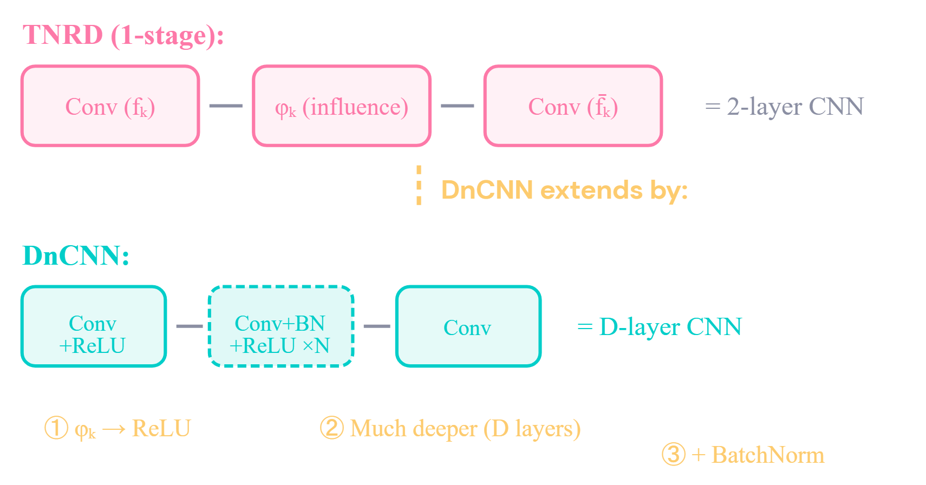
INTRODUCTION
INTRODUCTION
·
·
ARCHITECTURE
ARCHITECTURE
·
·
DATA & TRAINING
DATA & TRAINING
·
·
RESULTS
RESULTS
·
·
ANALYSIS
ANALYSIS
·
·
CONCLUSION
CONCLUSION
INTRODUCTION
From Classical Priors to Learned Features
Connection: DnCNN Generalizes TNRD
Classical Bayesian View
x̂ = argmin ½‖y − x‖² + λΦ(x)
Data fidelity + Regularization (explicit prior)
DnCNN: Learned Approach
v̂ = ℛ(y; Θ) ⇒ x̂ = y − v̂
No explicit prior — implicitly learned by CNN
Most DnCNN parameters represent learned image priors , analogous to the analysis prior in TNRD.
6 / 33
Notes:
Mathematical bridge: classical Bayesian view uses explicit prior Phi(x). DnCNN implicitly learns priors through CNN parameters. DnCNN generalizes one-stage TNRD by replacing influence functions with ReLU and adding depth + BN.

Slide 7

7 / 33
Notes:
Section transition: Architecture deep-dive.

Slide 8
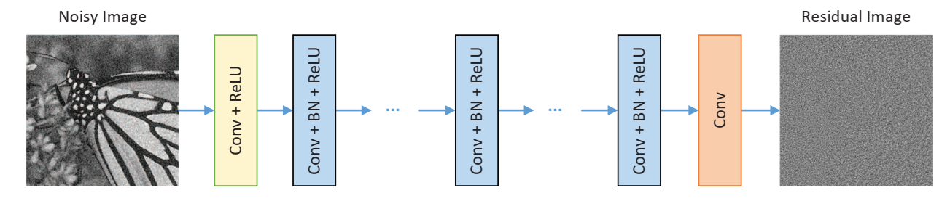
ARCHITECTURE
INTRODUCTION
ARCHITECTURE
INTRODUCTION
·
·
·
·
DATA & TRAINING
DATA & TRAINING
·
·
RESULTS
RESULTS
·
·
ANALYSIS
ANALYSIS
·
·
CONCLUSION
CONCLUSION
ARCHITECTURE
Network Architecture
Fig. 1 — DnCNN architecture [Zhang et al., 2017]
Key Design Decisions
Predict residual noise v̂, not clean image — then x̂ = y − v̂
FILTERS
FEATURE Maps
No pooling — preserves spatial resolution for pixel-level reconstruction
3×3
64
VGG principle: many small 3×3 filters with more nonlinearities, fewer params
POOLING
PARAMS
None
~556K
Batch Normalization in middle layers stabilizes residual learning
8 / 33
Notes:
DnCNN: three types of layers. Layer 1 = Conv+ReLU (64 filters 3×3). Middle layers = Conv+BN+ReLU (64 filters 3×3×64). Final layer = Conv (reconstructs residual). Key: no pooling preserves spatial resolution.

Slide 9
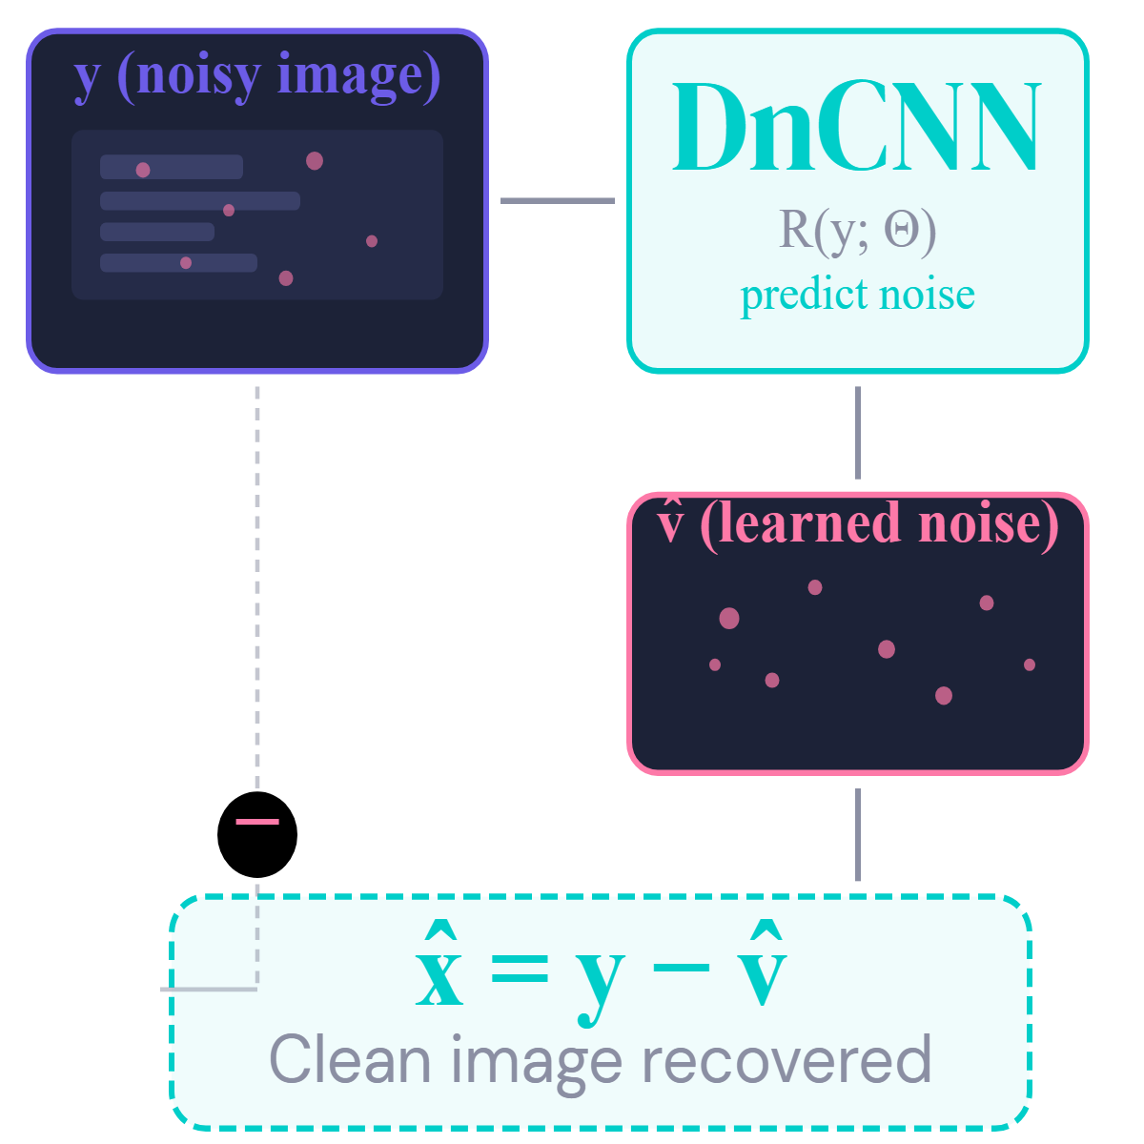
ARCHITECTURE
INTRODUCTION
ARCHITECTURE
INTRODUCTION
·
·
·
·
DATA & TRAINING
DATA & TRAINING
·
·
RESULTS
RESULTS
·
·
ANALYSIS
ANALYSIS
·
·
CONCLUSION
CONCLUSION
ARCHITECTURE
Residual Learning Strategy
Why Predict Noise Instead of Clean Image?
At low noise, y ≈ x → Learning F(y) ≈ identity is hard → Learning R(y) = v ≈ small perturbation is easy
Loss Function (MSE on Residual)
ℓ(Θ) = ¹⁄₂ₙ Σᵢ ‖ℛ(yᵢ; Θ) − (yᵢ − xᵢ)‖²
Minimizes distance between predicted and actual noise over N training pairs
9 / 33
Notes:
Why predict noise instead of clean image? At low noise y≈x, so identity mapping is hard. The residual (noise) is a small perturbation — much easier to learn. MSE loss on the residual.

Slide 10
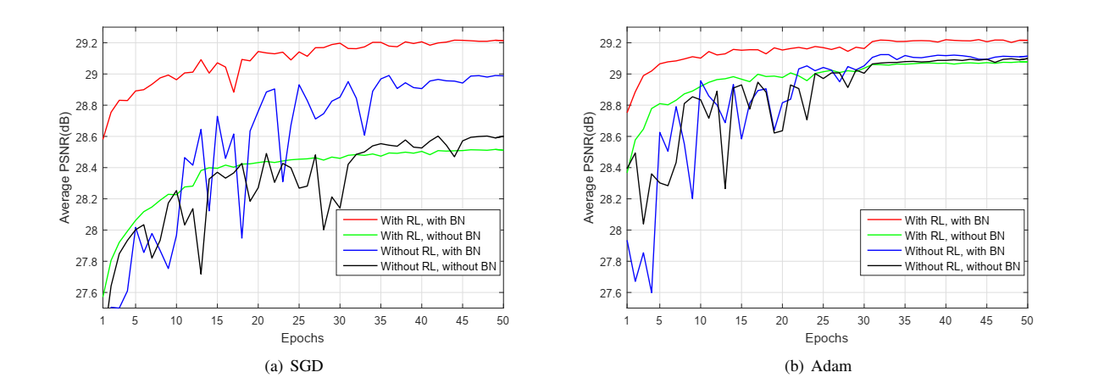
ARCHITECTURE
INTRODUCTION
ARCHITECTURE
INTRODUCTION
·
·
·
·
DATA & TRAINING
DATA & TRAINING
·
·
RESULTS
RESULTS
·
·
ANALYSIS
ANALYSIS
·
·
CONCLUSION
CONCLUSION
ARCHITECTURE
RL + BN Synergy
Residual Learning and Batch Normalization are mutually beneficial
Batch Histograms — Why BN Works with RL
RL Benefits from BN
BN alleviates internal covariate shift
Without BN, RL alone cannot match TNRD (28.92 dB)
BN enables stable training with higher learning rates
BN Benefits from RL
Without RL, BN can actually hurt convergence
RL makes hidden layer inputs Gaussian-like
Inputs become less correlated → ideal for BN
Consistent across both SGD and Adam — it's the RL+BN integration, not the optimizer.
Fig. 2 — RL+BN (red) converges fastest to highest PSNR across SGD and Adam
10 / 33
Notes:
Critical finding: RL and BN are synergistic. RL makes hidden layers Gaussian-like (ideal for BN). BN alleviates covariate shift (helps RL converge). Together: 29.16 dB. Neither alone gets close. Consistent across SGD and Adam.

Slide 11
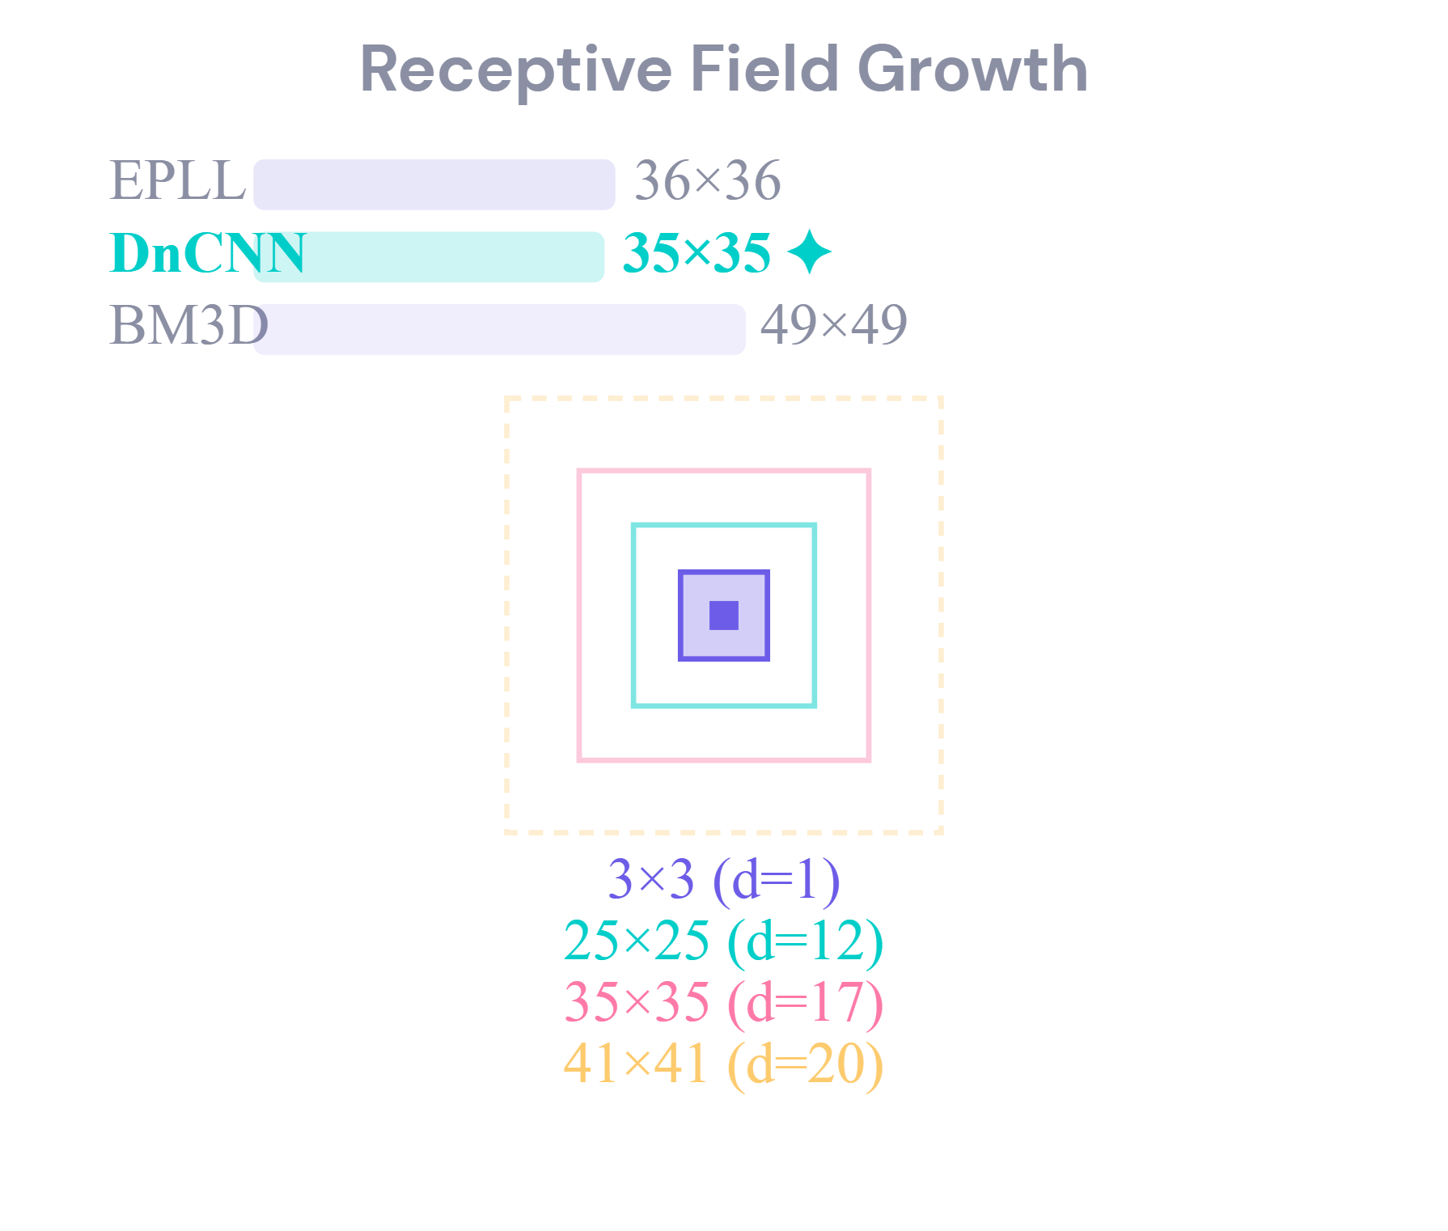
ARCHITECTURE
INTRODUCTION
ARCHITECTURE
INTRODUCTION
·
·
·
·
DATA & TRAINING
DATA & TRAINING
·
·
RESULTS
RESULTS
·
·
ANALYSIS
ANALYSIS
·
·
CONCLUSION
CONCLUSION
ARCHITECTURE
Network Depth & Receptive Field
RF = (2d + 1) × (2d + 1)
No pooling → each 3×3 conv adds 2 pixels to RF per side
DnCNN-S
Depth 17 · RF 35×35 Known noise level σ
DnCNN-B
Depth 20 · RF 41×41 Blind Gaussian denoising
DnCNN-3
Depth 20 · RF 41×41 Three tasks jointly
11 / 33
Notes:
Depth determines receptive field. RF = (2d+1)². No pooling, so each 3×3 conv adds 2px per side. DnCNN-S: depth 17, RF 35×35. DnCNN-B/3: depth 20, RF 41×41. VGG principle: many small filters.

Slide 12



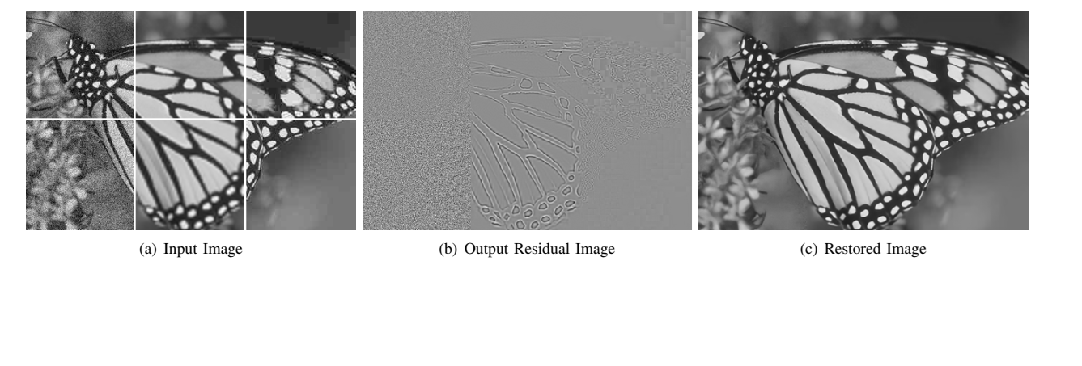
ARCHITECTURE
INTRODUCTION
ARCHITECTURE
INTRODUCTION
·
·
·
·
DATA & TRAINING
DATA & TRAINING
·
·
RESULTS
RESULTS
·
·
ANALYSIS
ANALYSIS
·
·
CONCLUSION
CONCLUSION
ARCHITECTURE
DnCNN-3: One Model, Three Tasks
Unifying Degradation Model
y = x + v
Denoising
Super-Resolution
JPEG Deblocking
v = AWGN σ ∈ [0, 55]
v = HR − bicubic(LR) ×2, ×3, ×4
v = orig − compressed QF 5–99
No previous method had handled all three tasks with one model.
Fig. 12 — One model handles 6 different degradations simultaneously
12 / 33
Notes:
DnCNN-3 unifies three tasks under y=x+v. All three noise types satisfy the TNRD residual condition. One model handles denoising, super-resolution, and JPEG deblocking.

Slide 13

13 / 33
Notes:
Section transition: Data and training methodology.

Slide 14
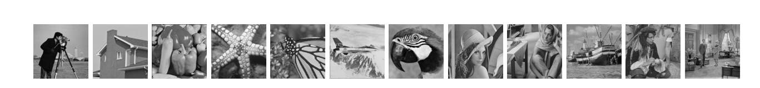
DATA & TRAINING
INTRODUCTION
DATA & TRAINING
INTRODUCTION
·
·
ARCHITECTURE
ARCHITECTURE
·
·
·
·
RESULTS
RESULTS
·
·
ANALYSIS
ANALYSIS
·
·
CONCLUSION
CONCLUSION
DATA & TRAINING
Datasets & Data Pipeline
MODEL
SOURCE
PATCHES
SIZE
NOISE
DnCNN-S
400 imgs (180²)
128×1,600
40×40
σ∈{15,25,50}
DnCNN-B
400 imgs (180²)
128×3,000
50×50
σ∈[0,55]
Data Pipeline
CDnCNN-B
432 BSD color
128×3,000
50×50
σ∈[0,55]
DnCNN-3
91+200 BSD
128×8,000
50×50
Mixed tasks
Test Datasets
BSD68: 68 natural images (primary benchmark)
12 classic test images
12 Classics: Lena, Barbara, Boat, etc.
SR: Set5, Set14, BSD100, Urban100
JPEG: Classic5, LIVE1
COMPLETE TRAINING PIPELINE
Source
→
Crop
→
Augment
→
+ Noise
→
Pair
→
Batch
→
DnCNN
→
Loss
400 images
40–50px patches
Rot + Flip
AWGN σ
{yᵢ, xᵢ}
128 patches
R(y; Θ) → v̂
MSE(v̂, v)
14 / 33
Notes:
Training data: 400 images for DnCNN-S, BSD for color. Patches extracted with augmentation. Test: BSD68, 12 classics, Set5/14, LIVE1. No overlap between train/test.

Slide 15
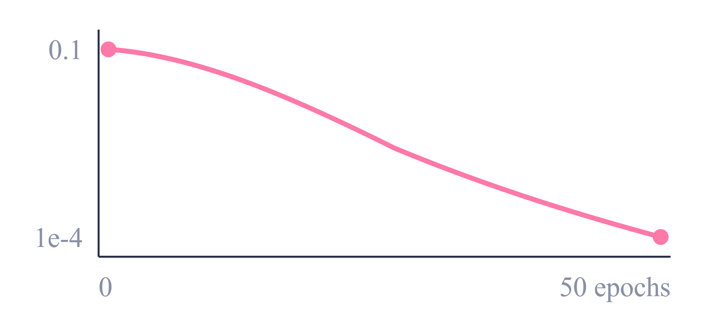
DATA & TRAINING
INTRODUCTION
DATA & TRAINING
INTRODUCTION
·
·
ARCHITECTURE
ARCHITECTURE
·
·
·
·
RESULTS
RESULTS
·
·
ANALYSIS
ANALYSIS
·
·
CONCLUSION
CONCLUSION
DATA & TRAINING
Training Configuration
Learning Rate Schedule
LOSS FUNCTION
OPTIMIZER
MSE
SGD
On residual ‖R(y;Θ)−(y−x)‖²
Momentum 0.9 · WD 1e-4
LEARNING RATE
BATCH SIZE
1e⁻¹ → 1e⁻⁴
128
Exponential decay / 50 ep.
Patch mini-batch SGD
INITIALIZATION
FRAMEWORK
He et al.
MatConvNet
Training Time
Variance scaling for ReLU
MATLAB-based CNN lib
DnCNN-S
~6h
CPU
GPU
DnCNN-B
~1 day
Intel i7-5820K CPU @ 3.30GHz
Nvidia Titan X GPU
DnCNN-3
~3 days
15 / 33
Notes:
SGD with momentum 0.9, weight decay 0.0001. Learning rate decays from 0.1 to 0.0001 over 50 epochs. He initialization. Batch size 128. Training: 6 hours to 3 days on Titan X.

Slide 16

16 / 33
Notes:
Section transition: Experimental results.

Slide 17
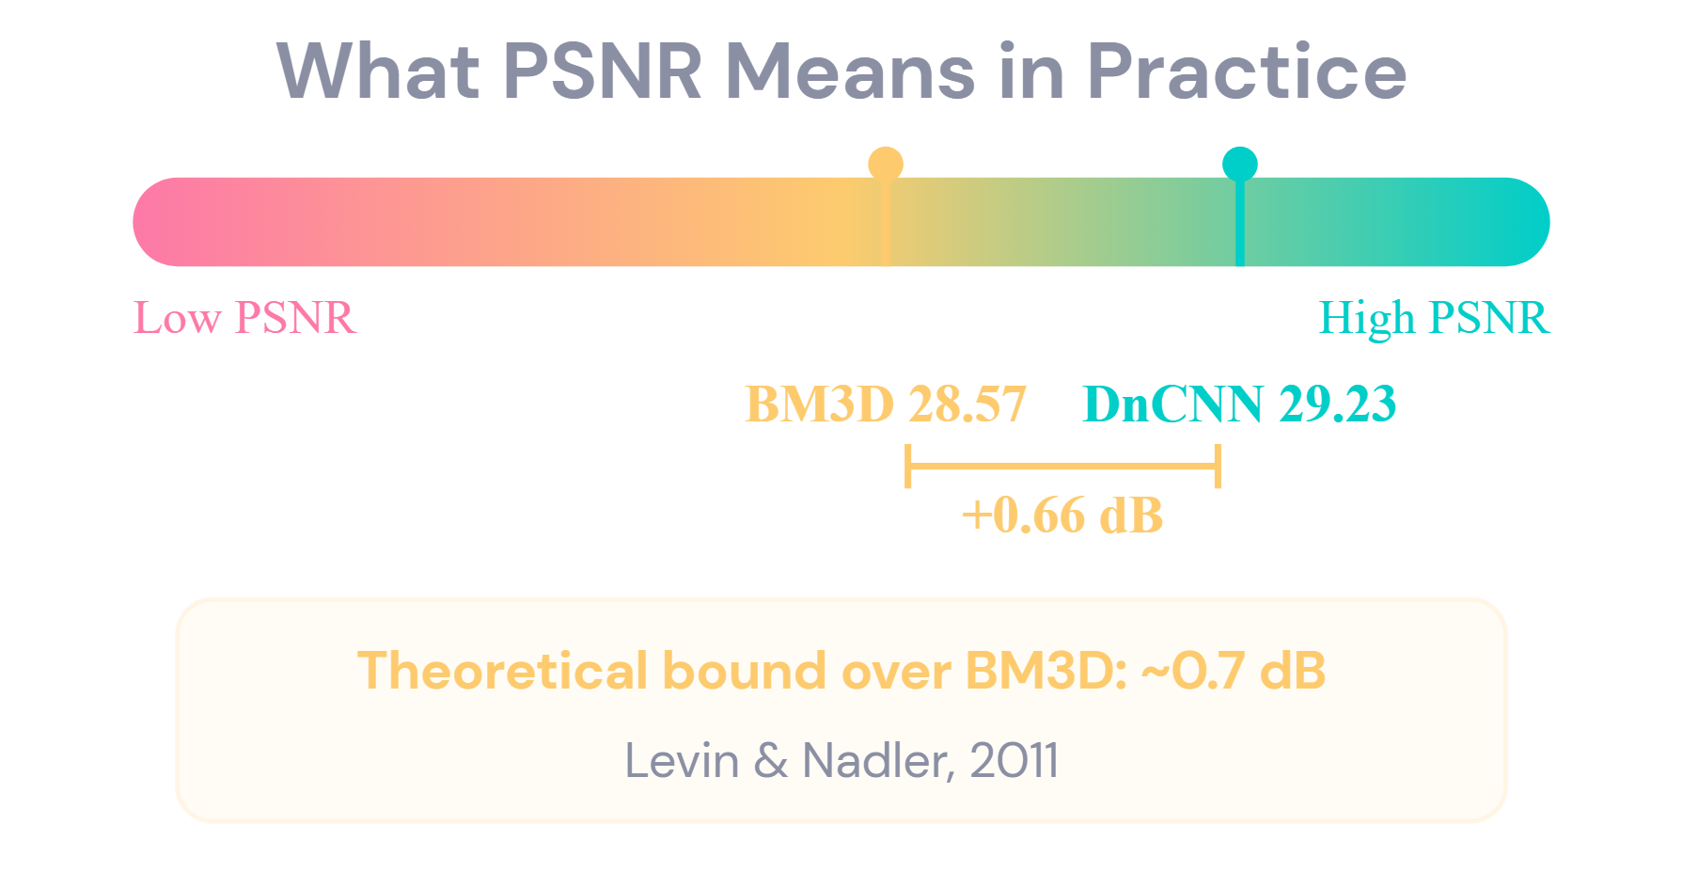
RESULTS
INTRODUCTION
RESULTS
INTRODUCTION
·
·
ARCHITECTURE
ARCHITECTURE
·
·
DATA & TRAINING
DATA & TRAINING
·
·
·
·
ANALYSIS
ANALYSIS
·
·
CONCLUSION
CONCLUSION
RESULTS
Evaluation Metrics
PSNR (Peak Signal-to-Noise Ratio)
PSNR = 10 · log₁₀(MAX² / MSE) dB
Higher = better · Standard metric for low-level vision
0.5 dB improvement is considered significant
Pixel-wise — may not match visual perception
SSIM (Structural Similarity Index)
SSIM(x, y) = f(luminance, contrast, structure)
Range [0, 1]: 1 = identical
Considers structural information, not just pixel error
Better correlates with human visual perception
Before DnCNN, few methods could beat BM3D by >0.3 dB on average. DnCNN-S achieves +0.6 dB — approaching the theoretical limit.
17 / 33
Notes:
PSNR measures pixel-level error in dB. Higher is better. 0.5 dB improvement is significant. SSIM measures structural similarity, correlates better with human perception. Levin & Nadler estimated BM3D theoretical bound at ~0.7 dB.

Slide 18
RESULTS
INTRODUCTION
RESULTS
INTRODUCTION
·
·
ARCHITECTURE
ARCHITECTURE
·
·
DATA & TRAINING
DATA & TRAINING
·
·
·
·
ANALYSIS
ANALYSIS
·
·
CONCLUSION
CONCLUSION
RESULTS
Gaussian Denoising — BSD68
Average PSNR (dB) comparison · Table II in paper
METHOD
Σ = 15
Σ = 25
Σ = 50
BM3D [Dabov '07]
31.07
28.57
25.62
+0.6 dB
WNNM [Gu '14]
31.37
28.83
25.87
EPLL [Zoran '11]
31.21
28.68
25.67
DnCNN-S over BM3D at all noise levels
MLP [Burger '12]
—
28.96
26.03
TNRD [Chen '16]
31.42
28.92
25.97
DnCNN-B (blind, unknown σ) still beats all noise-specific competitors
DnCNN-S
31.73
29.23
26.23
DnCNN-B (blind)
31.61
29.16
26.23
18 / 33
Notes:
BSD68 results: DnCNN-S outperforms BM3D by ~0.6 dB at ALL noise levels. DnCNN-B (blind, unknown sigma) still beats all noise-specific competitors. Approaching the theoretical bound.

Slide 19
RESULTS
INTRODUCTION
RESULTS
INTRODUCTION
·
·
ARCHITECTURE
ARCHITECTURE
·
·
DATA & TRAINING
DATA & TRAINING
·
·
·
·
ANALYSIS
ANALYSIS
·
·
CONCLUSION
CONCLUSION
RESULTS
Per-Image Analysis — σ = 25
IMAGE
BM3D
WNNM
TNRD
DNCNN-S
Δ BM3D
Strengths
C.man
29.45
29.64
29.72
30.18
+0.73
Best on most images at all σ
+0.2–0.6 dB on textured images
Sharp edges + clean smooth regions
House
32.85
33.22
32.53
33.06
+0.21
Barbara
30.71
31.24
29.41
30.00
−0.71
Where It Struggles
Parrot
28.93
29.15
29.18
29.43
+0.50
Barbara/House: repetitive patterns
Non-local methods (WNNM) win here
DnCNN lacks non-local prior
Avg (12)
29.97
30.26
30.06
30.44
+0.47
Irregular textures → DnCNN wins Regular patterns → non-local wins
19 / 33
Notes:
Per-image: DnCNN wins on most images. Exception: Barbara and House have repetitive patterns where non-local methods (WNNM) excel. Expected — DnCNN has only local receptive field.

Slide 20
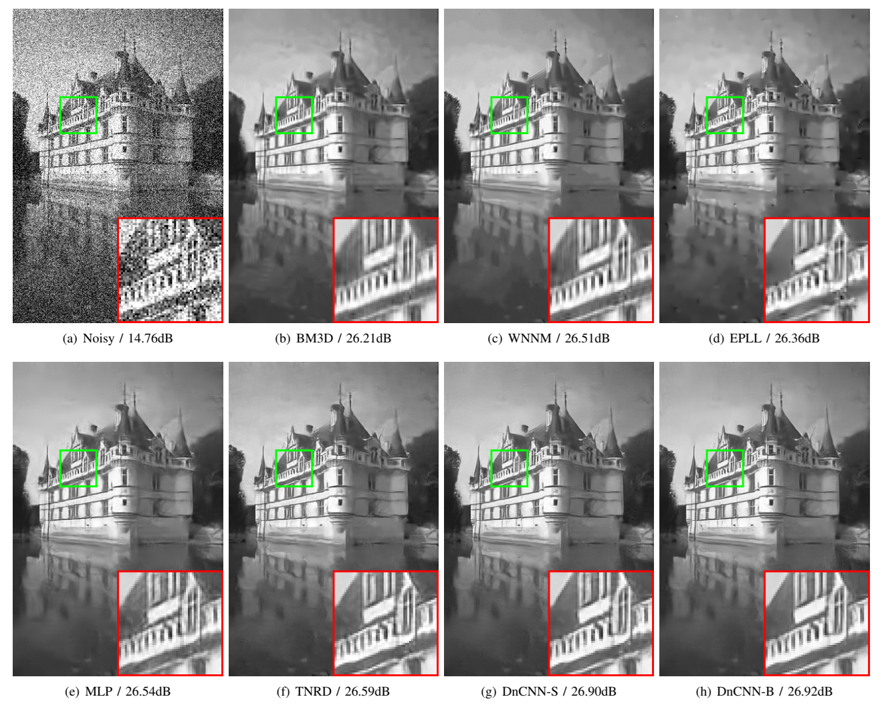
RESULTS
INTRODUCTION
RESULTS
INTRODUCTION
·
·
ARCHITECTURE
ARCHITECTURE
·
·
DATA & TRAINING
DATA & TRAINING
·
·
·
·
ANALYSIS
ANALYSIS
·
·
CONCLUSION
CONCLUSION
RESULTS
Visual Quality Comparison
Qualitative analysis at σ = 50
Fig. 4 — Castle at σ=50: BM3D over-smooths, TNRD has artifacts, DnCNN-S/B preserve edges + clean smooth areas
20 / 33
Notes:
Visual quality: BM3D/WNNM over-smooth. TNRD has smooth-region artifacts. DnCNN achieves sharp edges AND clean smooth regions — best of both worlds. CDnCNN-B produces more natural color than CBM3D.

Slide 21
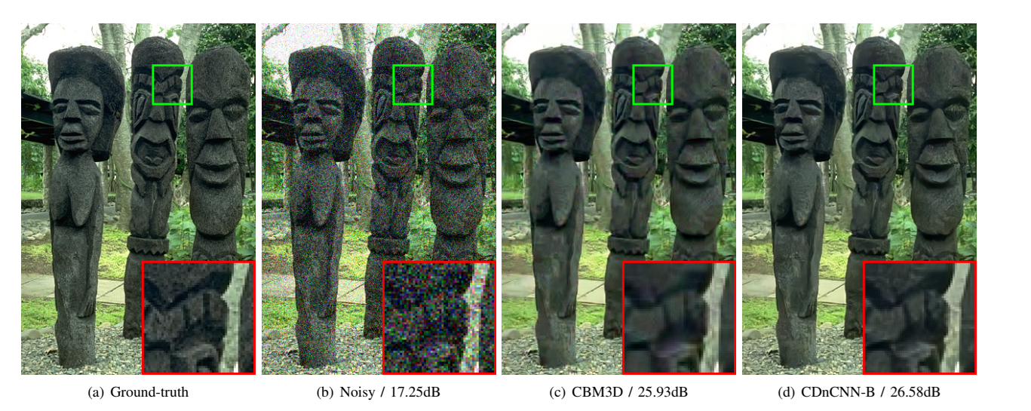
INTRODUCTION
·
ARCHITECTURE
·
DATA & TRAINING
·
RESULTS
·
ANALYSIS
·
CONCLUSION
RESULTS
Color Image Denoising
CDnCNN-B vs CBM3D — σ = 35
Fig. 6 — CDnCNN-B produces more natural color and sharper detail than CBM3D
21 / 33
Notes:
Blind denoising: DnCNN-B outperforms BM3D by 0.2-0.9 dB across all sigma. No noise estimation needed. DnCNN-3 matches or beats task-specific SOTA across denoising, SR, and JPEG deblocking with ONE model.

Slide 22
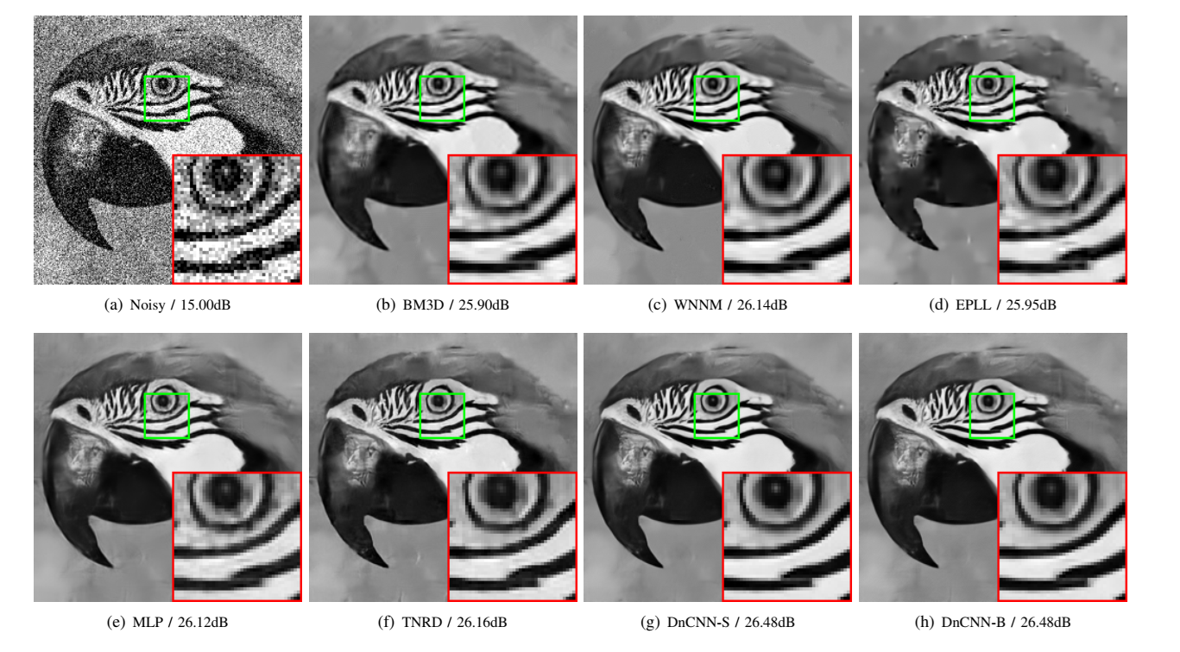
INTRODUCTION
·
ARCHITECTURE
·
DATA & TRAINING
·
RESULTS
·
ANALYSIS
·
CONCLUSION
RESULTS
Visual Quality — Parrot (σ = 25)
Fig. 5 — DnCNN preserves fine detail around the eye while keeping smooth regions clean
22 / 33
Notes:
Section transition: Critical analysis and deployment.

Slide 23
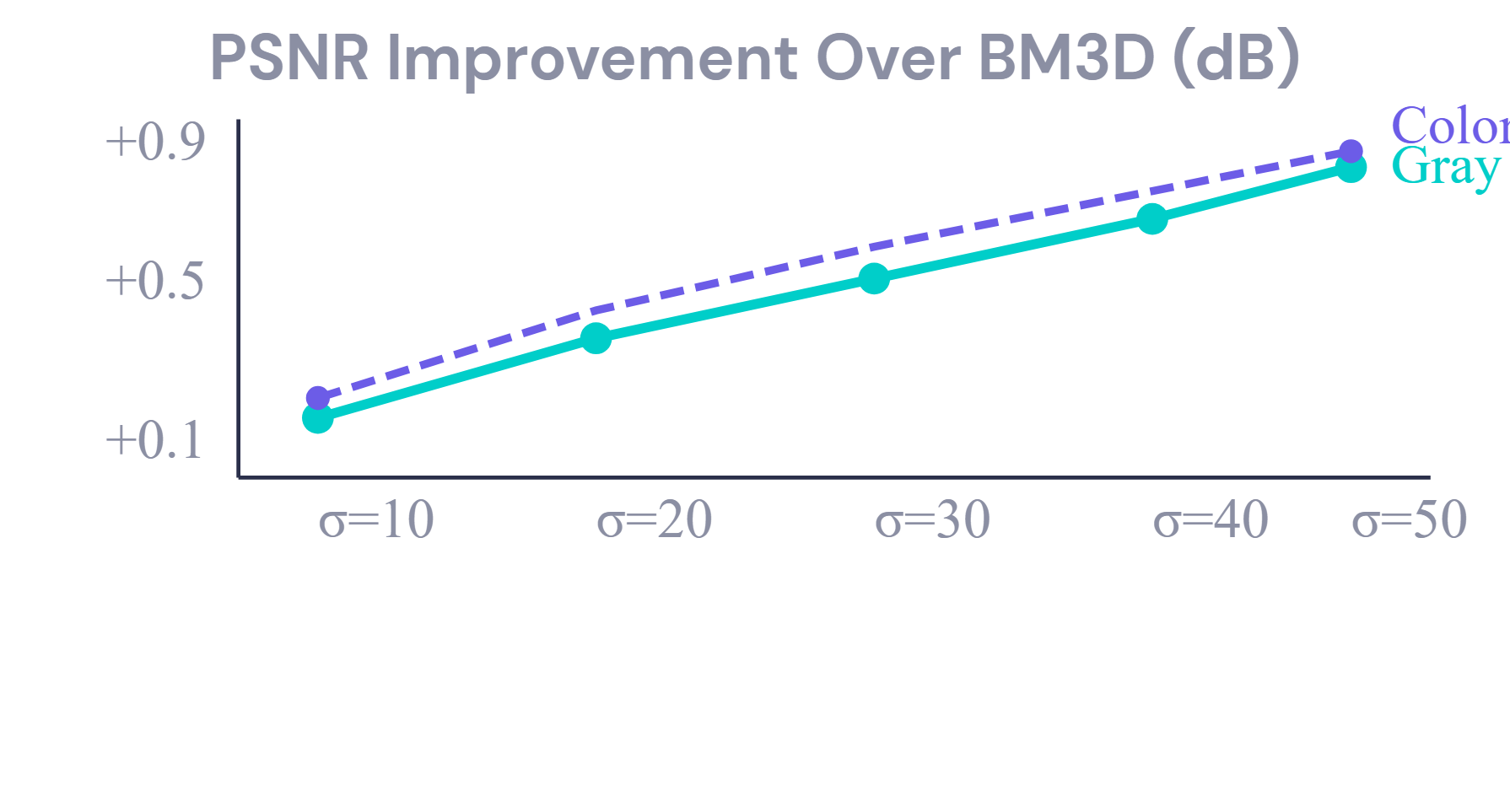
RESULTS
INTRODUCTION
RESULTS
INTRODUCTION
·
·
ARCHITECTURE
ARCHITECTURE
·
·
DATA & TRAINING
DATA & TRAINING
·
·
·
·
ANALYSIS
ANALYSIS
·
·
CONCLUSION
CONCLUSION
RESULTS
Blind & Multi-Task Performance
DnCNN-B: Blind Denoising
DnCNN-3: One Model, Three Tasks
Single model matches or beats task-specific SOTA across all three tasks.
No noise estimation step needed
Improvement increases with noise level
Single model simplifies deployment
23 / 33
Notes:
Runtime: 60ms for 512×512 on GPU. 12,000× faster than WNNM. Only ~556K parameters. Feed-forward = predictable latency. GPU-friendly operations.

Slide 24
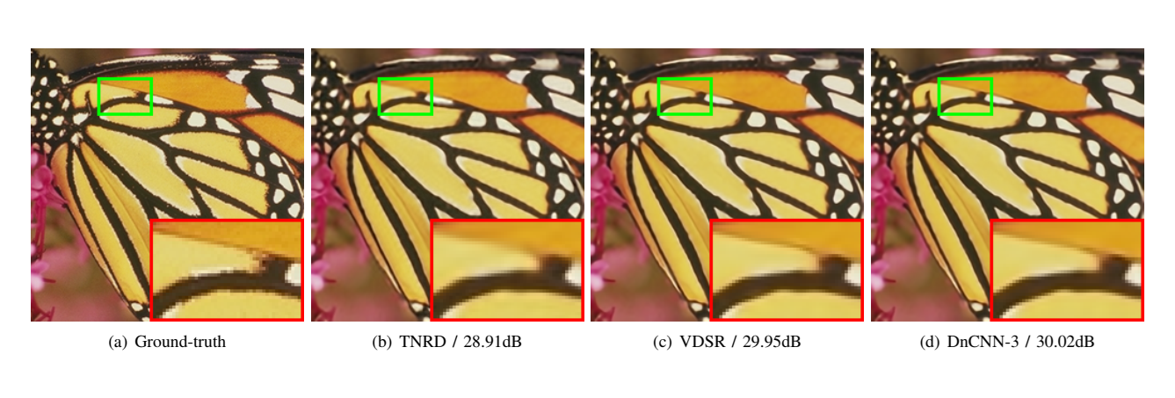
INTRODUCTION
·
ARCHITECTURE
·
DATA & TRAINING
·
RESULTS
·
ANALYSIS
·
CONCLUSION
RESULTS
Super-Resolution — DnCNN-3
Single model handles ×2, ×3, ×4 upscaling
Fig. 9 — SR ×3: DnCNN-3 (30.02 dB) outperforms TNRD (28.91 dB) and matches VDSR (29.95 dB)
24 / 33
Notes:
Model is lightweight by modern standards. Potential optimizations: pruning (30-50% reduction), INT8 quantization (2-4× memory savings), knowledge distillation, depthwise separable convolutions (8-9× FLOP reduction).

Slide 25
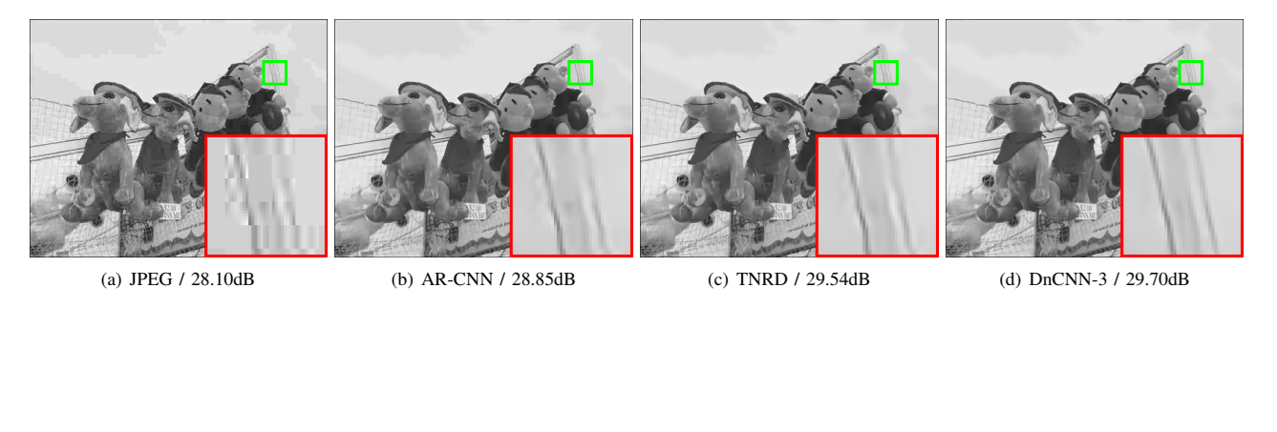
INTRODUCTION
·
ARCHITECTURE
·
DATA & TRAINING
·
RESULTS
·
ANALYSIS
·
CONCLUSION
RESULTS
JPEG Deblocking — DnCNN-3
Removing compression artifacts with a single multi-task model
Fig. 11 — JPEG QF 10: DnCNN-3 (29.70 dB) removes blocking artifacts better than AR-CNN and TNRD
25 / 33
Notes:
Four key limitations: (1) local RF can't exploit non-local similarity, (2) AWGN doesn't match real noise, (3) MSE optimizes PSNR not perception, (4) no attention or multi-scale. Each addressed by later works.

Slide 26

26 / 33
Notes:
Four contributions: residual learning for denoising, RL+BN synergy discovery, SOTA approaching theoretical bounds, blind + multi-task in single model.

Slide 27
ANALYSIS
INTRODUCTION
ANALYSIS
INTRODUCTION
·
·
ARCHITECTURE
ARCHITECTURE
·
·
DATA & TRAINING
DATA & TRAINING
·
·
RESULTS
RESULTS
·
·
·
·
CONCLUSION
CONCLUSION
COMPLEXITY
Runtime & Computational Efficiency
DnCNN on GPU — 60ms for 512×512 (real-time capable)
METHOD
256²
512²
1024²
BM3D
0.65s
2.85s
11.89s
WNNM — 773s for same image (12,000× slower)
WNNM
203s
773s
2536s
EPLL
25.4s
45.5s
422s
Feed-forward inference → predictable latency
TNRD (GPU)
0.010s
0.032s
0.116s
DnCNN-S (GPU)
0.014s
0.051s
0.200s
All ops are standard conv/BN → cuDNN accelerated
DnCNN-B (GPU)
0.016s
0.060s
0.235s
60ms
12K×
556K
512×512 GPU
vs WNNM
parameters
27 / 33
Notes:
DnCNN established residual learning + BN as the standard. Influenced SwinIR, Restormer, DRUNet. Open questions: real-world noise, perceptual quality, efficient deployment, self-supervised training.

Slide 28




ANALYSIS
INTRODUCTION
ANALYSIS
INTRODUCTION
·
·
ARCHITECTURE
ARCHITECTURE
·
·
DATA & TRAINING
DATA & TRAINING
·
·
RESULTS
RESULTS
·
·
·
·
CONCLUSION
CONCLUSION
COMPLEXITY
Model Complexity & Optimization
Parameter Breakdown
Potential Optimization Strategies
Layer 1: 3×3×1×64
576
Pruning Remove redundant filters — 30-50% param reduction
Layers 2-16: 15×(3×3×64×64)
552,960
Layer 17: 3×3×64×1
576
BN params: 15×2×64
1,920
Quantization INT8/FP16 — 2-4× memory reduction
Total
~556K params
Deployment Advantages
Knowledge Distillation Shallower student from DnCNN teacher
Feed-forward: fixed computation per pixel
GPU-friendly: standard conv/BN ops
cuDNN v5 acceleration supported
Predictable latency, no iteration
Depthwise Separable Conv Replace standard convs — ~8-9× FLOP reduction
28 / 33
Notes:
Key references: Zhang 2017 (this paper), Dabov 2007 (BM3D), He 2016 (ResNet), Ioffe 2015 (BatchNorm), Chen 2016 (TNRD), plus others.

Slide 29
ANALYSIS
INTRODUCTION
ANALYSIS
INTRODUCTION
·
·
ARCHITECTURE
ARCHITECTURE
·
·
DATA & TRAINING
DATA & TRAINING
·
·
RESULTS
RESULTS
·
·
·
·
CONCLUSION
CONCLUSION
CRITICAL ANALYSIS
Limitations & Failure Cases
Non-Local Patterns
AWGN Assumption
Local RF cannot exploit long-range self-similarity. WNNM/BM3D win on Barbara (-0.71 dB vs BM3D).
Real-world noise is signal-dependent, spatially varying. AWGN is a simplification that limits practical applicability.
No Perceptual Loss
Fixed Architecture
✓
?
High PSNR
Perceptual quality
No attention
No multi-scale
No adaptation
Later works (DRUNet, SwinIR, Restormer) showed attention + multi-scale significantly improve results.
MSE optimizes PSNR, not visual quality. GANs and perceptual losses (SRGAN) showed these can diverge.
29 / 33
Notes:
Thank you. Questions and discussion.

Slide 30
CONCLUSION
INTRODUCTION
CONCLUSION
INTRODUCTION
·
·
ARCHITECTURE
ARCHITECTURE
·
·
DATA & TRAINING
DATA & TRAINING
·
·
RESULTS
RESULTS
·
·
ANALYSIS
ANALYSIS
·
·
CONCLUSION
Key Contributions & Impact
1
Residual Learning for Denoising
2
RL + BN Synergy
First to predict v̂ (noise) instead of x̂ (clean). Connected theoretically to TNRD.
RL makes inputs Gaussian-like → ideal for BN. BN stabilizes RL. Together: fastest convergence, best quality.
3
SOTA Performance
4
Blind & Multi-Task
One model for unknown σ (DnCNN-B). One model for 3 tasks (DnCNN-3). Both beat task-specific SOTA.
+0.6 dB over BM3D · Approaching theoretical bound · 60ms on GPU
DnCNN is cited 6,000+ times and established residual learning + BN as the standard denoising paradigm.
30 / 33

Slide 31






CONCLUSION
INTRODUCTION
CONCLUSION
INTRODUCTION
·
·
ARCHITECTURE
ARCHITECTURE
·
·
DATA & TRAINING
DATA & TRAINING
·
·
RESULTS
RESULTS
·
·
ANALYSIS
ANALYSIS
·
·
FUTURE WORK
Research Directions & Legacy
Attention
Losses
Noise
Non-Local Attention
Perceptual & GAN
Real-World Noise
Self-attention blocks to capture long-range dependencies DnCNN misses
VGG perceptual loss + adversarial training for visual realism over PSNR
Signal-dependent, spatially varying, sensor-specific noise models
→ Non-local Neural Networks, NLRN
→ SRGAN, ESRGAN
→ FFDNet, CBDNet, SCUNet
Efficiency
Architecture
Self-Supervised
Lightweight Models
Transformers & U-Nets
No Clean Images
NAS, depthwise convolutions, distillation for mobile/edge deployment
Multi-scale + attention architectures built on DnCNN's foundations
Train denoiser without ground truth clean images
→ ECBSR, IMDN
→ SwinIR, Restormer, DRUNet
→ Noise2Noise, Noise2Void
31 / 33

Slide 32
CONCLUSION
INTRODUCTION
CONCLUSION
INTRODUCTION
·
·
ARCHITECTURE
ARCHITECTURE
·
·
DATA & TRAINING
DATA & TRAINING
·
·
RESULTS
RESULTS
·
·
ANALYSIS
ANALYSIS
·
·
REFERENCES
Key References
[1] K. Zhang et al., "Beyond a Gaussian Denoiser: Residual Learning of Deep CNN for Image Denoising," IEEE TIP, 2017.
[2] K. Dabov et al., "Image denoising by sparse 3-D transform-domain collaborative filtering" (BM3D), IEEE TIP , 2007.
[3] K. He et al., "Deep Residual Learning for Image Recognition" (ResNet), CVPR, 2016.
[4] S. Ioffe & C. Szegedy, "Batch Normalization: Accelerating Deep Network Training," ICML, 2015.
[5] Y. Chen & T. Pock, "Trainable Nonlinear Reaction Diffusion" (TNRD), IEEE TPAMI, 2016.
[6] S. Gu et al., "Weighted Nuclear Norm Minimization" (WNNM), CVPR, 2014.
[7] J. Kim et al., "Accurate Image Super-Resolution Using Very Deep CNNs" (VDSR), CVPR, 2016.
[8] K. Simonyan & A. Zisserman, "Very Deep Convolutional Networks" (VGG), ICLR, 2015.
[9] A. Levin & B. Nadler, "Natural Image Denoising: Optimality and Inherent Bounds," CVPR, 2011.
[10] U. Schmidt & S. Roth, "Shrinkage Fields for Effective Image Restoration" (CSF), CVPR, 2014.
32 / 33

Slide 33
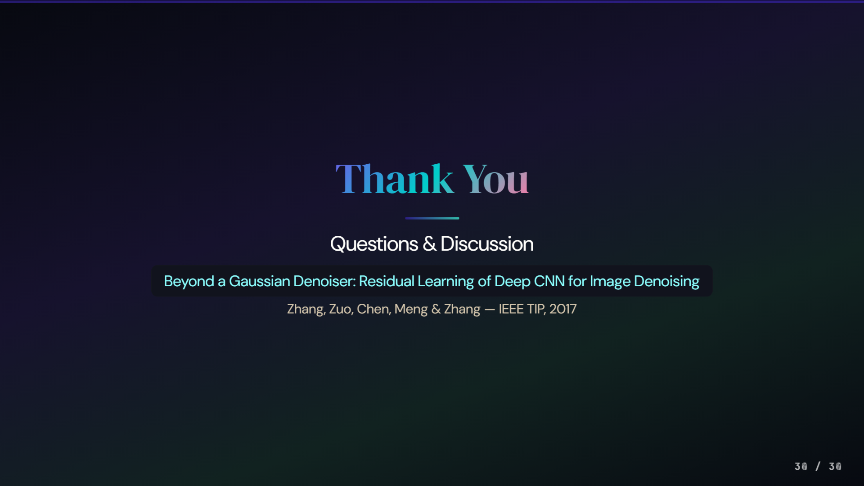
30 / 30
34 / 34
33 / 33

